Slide 1
A Level Maths Transition Work

Slide 2
What do you do in your first year?
There are THREE strands:
Pure Mathematics
This covers the techniques primarily focused on Number and Algebra and is needed to apply maths to a range of problems including calculus, further trigonometry, logarithms and exponentials.
Statistics
This covers the use of Maths as a statistical tool to collect, represent and analyse data as well as investigating probability and it’s applications.
Mechanics
This covers the modelling of Forces and Velocity to solve a variety of engineering style problems.

Slide 3
Am I right for this course? How many of these statements fit your personality?
I am predicted a 6 grade or above for maths GCSE.
I am confident in manipulating algebraic expressions and solving equations.
I have the ability to understand difficult concepts and apply these to problems, taking a flexible approach at times.
I have good time management, resilience and the ability to work independently and with other students.
I enjoy solving complex problems with many steps and can communicate my answers clearly and logically.
I can meet deadlines and work under a lot of pressure.
I am prepared to work hard to close any gaps in my knowledge seeking help outside of lessons where necessary.
I am enthusiastic in class and love to participate in discussions.
If you recognised yourself in many of these statements then this is the course for you!

Slide 4
Key Message!
A Level Maths is a challenging, yet rewarding course and is a step up from GCSE. Be prepared to meet new concepts and ideas in class and put these into practice outside of lessons.
You will often need to work together and seek help from your teachers outside of lesson time.

Slide 5
Summer Bridging Work: ESSENTIAL
During the summer holiday you will be expected to complete the following:
1. Complete the A Level transition assignment. This covers some of the grade 7-9 GCSE topics which you will be expected to know from the start of the course. You must complete all the questions and communicate your working out clearly to show how you arrived at the answer.
2. Revise for an initial exam in the 1st half term of the course. It is essential that students achieve a pass in this exam in order to continue the course. The test will cover the same topics as the transition assignment and will ensure that you have the basic knowledge required to begin the course.

Slide 6
Summer Bridging Work: RECOMMENDED
Complete any extra practice. Additional practice questions are attached to provide additional help for topics which you find more difficult.
Use a GCSE textbook or revision notes from last year to brush up on any of the topics you are unsure of and help with revision for the test.
Use GCSE past papers to help practice the 7-9 grade questions which appear in the last half of the paper.
Seek help from your teachers and friends to ensure you are well prepared for the entrance exam and to begin the course.
Do Maths regularly during the holidays rather than doing all the preparation in one block to ensure you are constantly reminded of the topics and techniques needed.

Slide 7
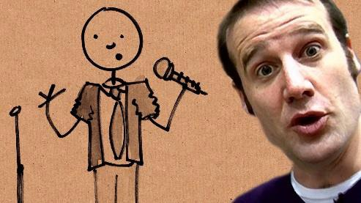
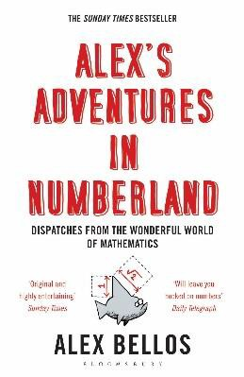
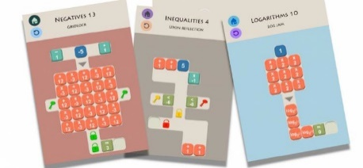
Broaden you Mathematical Horizon
Investigate YouTube
Look for the Numberphile channel or videos by the 'Festival of the Spoken’ nerd team
Read a book and follow the authors on social media
‘Alex’s Adventures in Numberland’
'Bad Science’ by Ben Goldare
'Professor Stewart's hoard of mathematical
treasures’ by Ian Stewart (one of many titles)
‘The indisputable existence of Santa Claus: The mathematics of Christmas’ by Dr Hannah Fry & Dr Thomas Oleron Evans
Try a “Maths” App - Sumaze Number and logic problems in a maze-style game. If you have a lot of free time Sumaze 1 can be done in under two days
Watch a Film
'Hidden Figures’ PG
'Beautiful Mind’ 12
'The Imitation Game’ 12
You'll be surprised how many results you get if you
Google 'maths films on Netflix’

Slide 8
Find some Maths “Problems” to solve
Brilliant.org has an enormous number of problems, spanning all the topics you can think of and all the ones you’ve never heard of
UKMT – The maths challenges you know and love. You’ll all be doing the Senior Maths Challenge in November. What better time than now to start practising.!
Know how to print “Hello World” in python? Doing Computing next year?
Get some extra coding practise and test your ability to problem solve by tackling some of the problems at ProjectEuler.net
Problem 1: What is the sum of all the multiples of 3 or 5 below 10?
Now find the sum of all the multiples of 3 or 5 below 1000

Slide 9
What can I do with this A level?
Mathematics is one of the top facilitating A-levels as recognised by Russell group universities and so can lead to a range of degree courses and is especially suited to any of the science, technology, engineering and maths based courses. It can lead to many careers including finance and banking, actuarial and insurance, IT, engineering, medicine and health, business and education.

