Slide 1
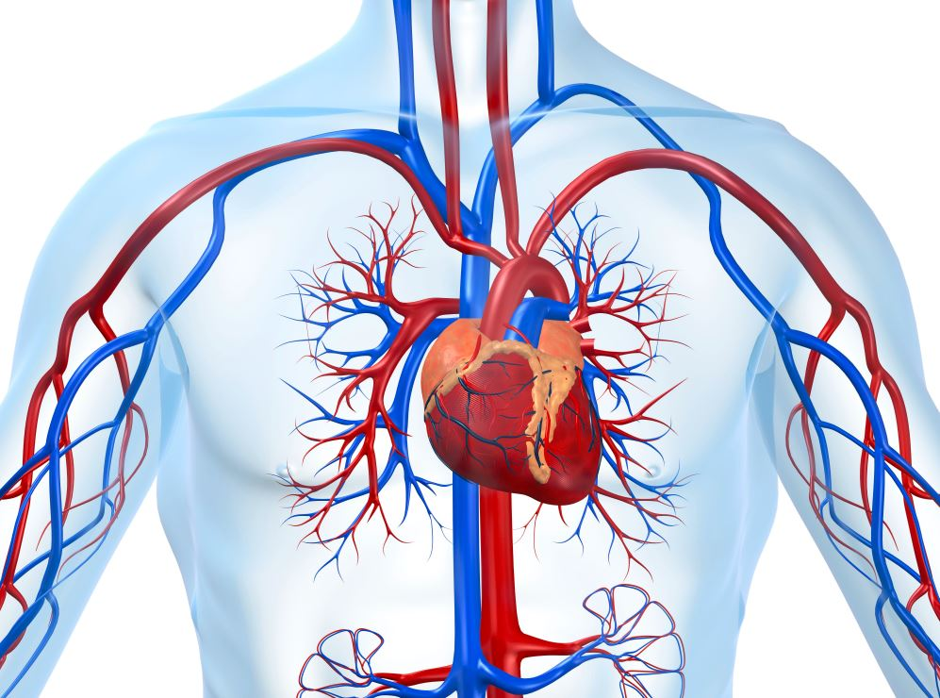
‘Click and Teach’ GCSE BIOLOGY
TOPIC: The Heart and Blood
1 hour ‘lecture lesson’
You should have your book (or paper) and a pen ☺

Slide 2
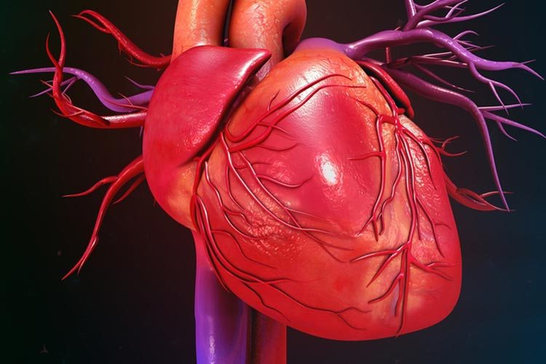
Aims of the lesson
To state the function of the heart and blood
To know the main structures of the heart and the components of the blood
To understand how the structure of the heart and blood cells relate to their function
In order to maintain social distancing and keep everyone safe:
You will need to copy from the board, rather than have worksheets
There will be EASY, MEDIUM or HARDER tasks for different abilities in the room
(c) Put your hand up if you need some help, but don’t leave your seat.
(d) Don’t share equipment, and keep your work with you at the end of the lesson.

Slide 3
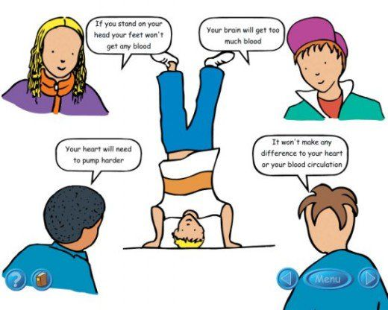
Title: The Heart
10 minute task:
Try and complete all three tasks if you think you can.
Easy: Copy each statement, and write down whether you think it’s true or false.
Medium: Rewrite any statement that you think is false, to make it true.
Hard: Explain why you think a statement is true or false.

Slide 4
Answers:
Discussion: What did you think?
First person: True, Your heart is having to pump blood further against the effect of gravity and at the same time is receiving a greater quantity of blood
Second person: Note really true. Your heart is working against gravity so your feet will get less blood rather than none.
Third person: True. Blood will pool in the brain when upside down, which can be dangerous.
Fourth person: Not true – the circulatory system is designed to work with the body in an upright position, so it will have an affect on your heart and circulation

Slide 5
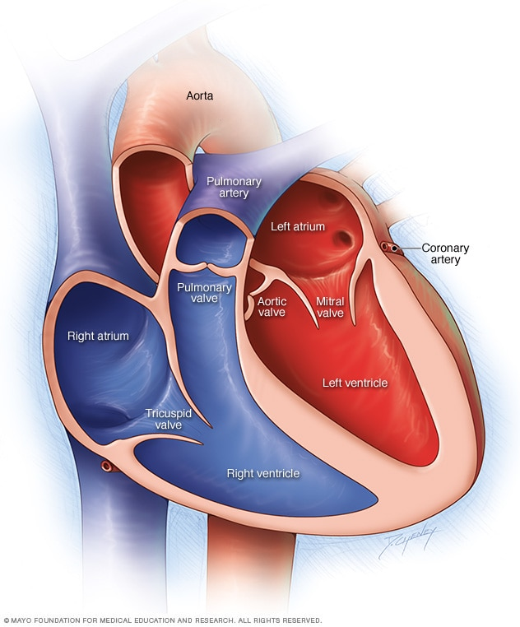
Title: The heart Watch this 3 minute clip. They’ll be some simple questions to answer afterwards. Feel free to make some notes as you watch ☺
https://www.youtube.com/watch?v=CWFyxn0qDEU

Slide 6
Copy and answer ✓ Questions:
EASY
What is the job of the heart?
Which side of the heart carries (a) oxygen-rich blood? (b) oxygen-poor blood?
MEDIUM
3) What are the valves in the heart called and what is their function?
4) Why do you think the wall of the left side of the heart is thicker than the wall of the right?
HARDER
5) Some babies are born with a hole in the septum (the part that separates the two sides of the heart) – why is this a problem?

Slide 7
Answers ☺:
EASY
What is the job of the heart? To pump blood (carrying oxygen) around the body
Which side of the heart carries (a) oxygen-rich blood? Left side (b) oxygen-poor blood? Right side
MEDIUM
3) What are the valves in the heart called and what is their function? Tricuspid, bicuspid (mitral), and semi-lunar valves. They stop blood from moving in the wrong directin.
4) Why do you think the wall of the left side of the heart is thicker than the wall of the right? The left side pumps blood all the way around the body
HARDER
5) Some babies are born with a hole in the septum (the part that separates the two sides of the heart) – why is this a problem? Oxygen-poor blood can mix with oxygen-rich blood. This means that the blood going around the body is carrying less oxygen.

Slide 8
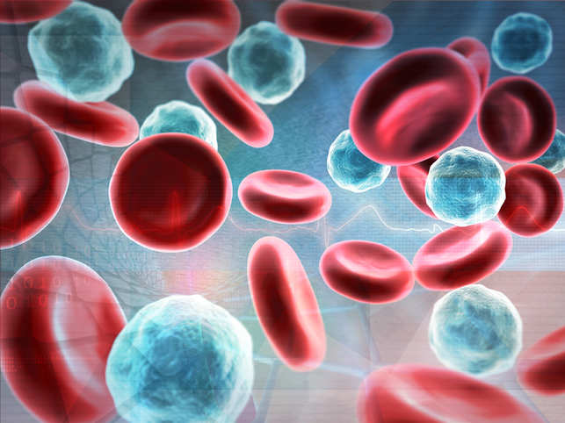
Title: Blood Watch this 3 minute video clip. They’ll be some questions and tasks to complete afterwards. You might want to make some notes as you go along, if you can multi-task ☺ https://www.youtube.com/watch?v=qrE6Y0Se8bw

Slide 9
Copy and answer ✓ Questions:
EASY
What is the single largest component of blood?
Where are red blood cells made?
MEDIUM
3) What are the 4 components of the blood?
4) What protein do red blood cells contain and what is the role of this protein?
5) What is the job of a) white blood cells? b) platelets?
HARDER
5) Why is oxygen needed by the cells of the body?
6) How are red blood cells adapted to their job?

Slide 10
Answers ☺:
EASY
What is the single largest component of blood? Plasma
Where are red blood cells made? In the bone marrow
MEDIUM
3) What are the 4 components of the blood? Red blood cells, white blood cells and platelets
4) What protein do red blood cells contain and what is the role of this protein? Haemoglobin, which binds to oxygen
5) What is the job of a) white blood cells? They protect against disease and fight infections b) platelets They form blood clots
HARDER
5) Why is oxygen needed by the cells of the body? For aerobic respiration to make energy in the form of ATP
6) How are red blood cells adapted to their job? They contain haemoglobin to bind to oxygen, they have a biconcave shape to increase their surface area for oxygen to diffuse in, they don’t have a nucleus so there is more room for haemoglobin and they are flexible so they can fit through narrow blood vessels.

Slide 11
Aims of the lesson – how did we do?
To state the function of the heart and blood
To know the main structures of the heart and the components of the blood
To understand how the structure of the heart and blood cells relate to their function

